Slide 1
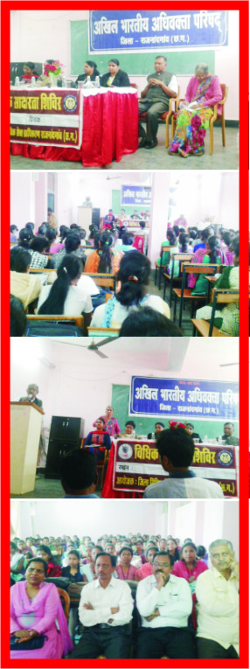
dq- vkcsnk csxe lgk;d izk/;kid jktuhfr foKku foHkkxh; tkudkjh ¼2017&18½ “kkldh; deyk nsoh jkBh efgyk LukrdksRrj egk- jktukanxkao ¼N-x-½
Ø-
fnukad
“kh’kZd] dk;Zdze
fo’k; fo'ks’kK @ izeq[k oDrk-
ykHkkfUor Nk=k,a d{kk dk uke dk;Zdze dh mi;ksfxrk
QksVks xSyjh
1-
27-11-17
^^Lkafo/kku] ewy vf/kdkj] ewy drZO;^^
Jh ujsUnz Bkdqj lnL; jk’Vªh; ifj’kn vf[ky Hkkjrh; vf/koDrk ifj’kn
Ckh-,- Hkkx ,d] nks rhu] ,e-,- izFke ,oa r`rh; lsesLVj jkt- foKku] ,e-,- izFke ,oa r`rh; lsesLVj euksfoKku
dk;Zdze vR;ar lkjxfHkZr] Kkuo/kZd] izsjd vkSj mi;ksxh jgkA
^^Lkafo/kku ds fofHkUu vuqPNsn^^
Jh veysUnq gktjk] yksddyk
^^Lkafo/kku dh fo’ksrkvk,a] ekr` “kfDr] jk’VªHkfDr ,oa laxzke ftanxh gS dh izsjd vfHkO;fDr^^
Jh fo’.kq lko] “kkldh; vfHkHkk’kd
^^efgykvksa ds vf/kdkj rFkk efgykvksa ds laca/k esa dkuwu^^
Jherh eksfguh daoj] eq[; U;kf;d n.Mkf/kdkjh ftyk jktukanxkao
^^laafo/kku ,oa tkx:drk^^
Mk- ¼Jherh½ ch-,u- esJke }kjk mncks/ku

Slide 2
dq- vkcsnk csxe lgk;d izk/;kid jktuhfr foKku foHkkxh; tkudkjh ¼2017&18½ “kkldh; deyk nsoh jkBh efgyk LukrdksRrj egk- jktukanxkao ¼N-x-½
Ø-
fnukad
“kh’kZd] dk;Zdze
fo’k; fo'ks’kK @ izeq[k oDrk-
ykHkkfUor Nk=k,a d{kk dk uke dk;Zdze dh mi;ksfxrk
QksVks xSyjh
1-
27-11-17
^^Lkafo/kku] ewy vf/kdkj] ewy drZO;^^
Jh ujsUnz Bkdqj lnL; jk’Vªh; ifj’kn vf[ky Hkkjrh; vf/koDrk ifj’kn
Ckh-,- Hkkx ,d] nks rhu] ,e-,- izFke ,oa r`rh; lsesLVj jkt- foKku] ,e-,- izFke ,oa r`rh; lsesLVj euksfoKku
dk;Zdze vR;ar lkjxfHkZr] Kkuo/kZd] izsjd vkSj mi;ksxh jgkA
^^Lkafo/kku ds fofHkUu vuqPNsn^^
Jh veysUnq gktjk] yksddyk
^^Lkafo/kku dh fo’ksrkvk,a] ekr` “kfDr] jk’VªHkfDr ,oa laxzke ftanxh gS dh izsjd vfHkO;fDr^^
Jh fo’.kq lko] “kkldh; vfHkHkk’kd
^^efgykvksa ds vf/kdkj rFkk efgykvksa ds laca/k esa dkuwu^^
Jherh eksfguh daoj] eq[; U;kf;d n.Mkf/kdkjh ftyk jktukanxkao
^^laafo/kku ,oa tkx:drk^^
Mk- ¼Jherh½ ch-,u- esJke }kjk mncks/ku

